Slide 1

Lookalike Model Validation (TSNE)
Xin Zhao
July 15th 2020

Slide 2
Data Visualization
Reduce features into 2 dimensions with TSNE (dimension reduction technique)
Separate users based on different similarity groups (eg. >= 80 vs. <=20)
Plot users to compare separation between the similarity groups
Great model should successful separate users from two groups

Slide 3
Sample Segment 1: Segment of Globe Ad Clickers - ADC, all users that clicked on ads in the last 90 days (794,628 users)
Score | # of Lookalikes | % of Lookalikes
90-99 | 7,763 | 0.015%
80-90 | 55,313 | 0.105%
70-80 | 114,356 | 0.217%
60-70 | 325,467 | 0.618%
50-60 | 4,708,308 | 8.933%
40-50 | 42,184,563 | 80.039%
30-40 | 247,334 | 0.469%
20-30 | 117,305 | 0.223%
10-20 | 101,158 | 0.192%
0-10 | 4,843,244 | 9.189%
Total | 52,704,811 | 100.000%
Notes:
/mnt/tgam_adc_s3/wecloud/segments/date=2020-06-24/7065d3ef-57f8-4858-a63c-a84c64aa287a.csv

Slide 4
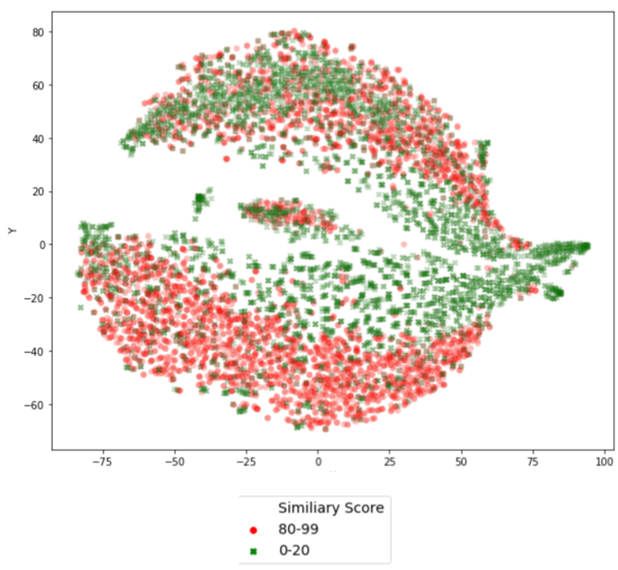
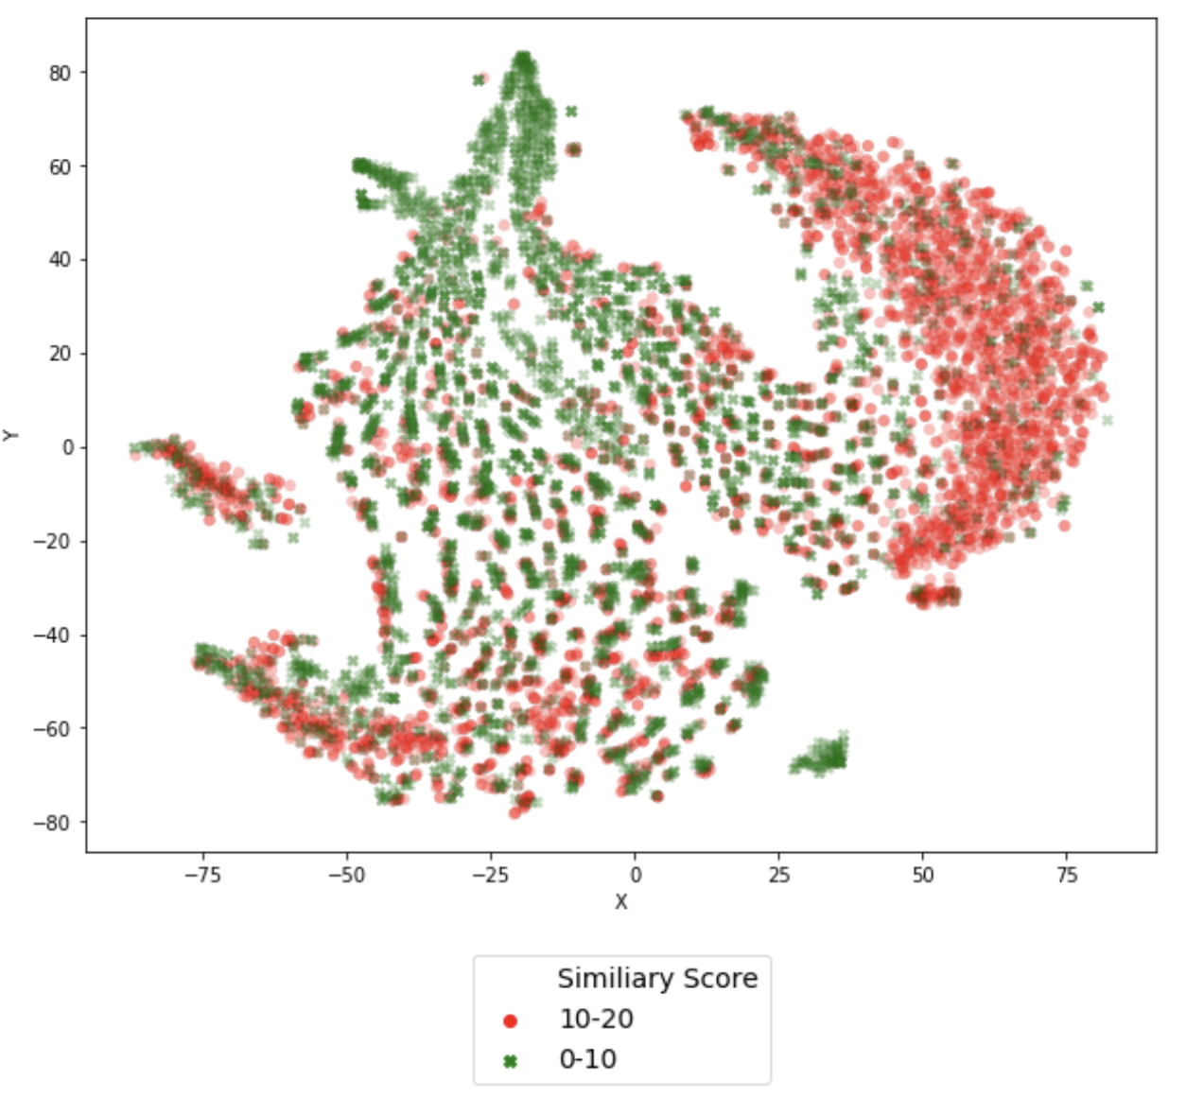
80-99 VS 0-20, 10-20 VS 0-10

Slide 5
Sample Segment 2: Segment of Globe Anonymous users who visited the site at least 3 times in last 30 Days (532,577 users)
Score | # of Lookalikes | % of Lookalikes
90-99 | 7,998 | 0.015%
80-90 | 411,295 | 0.777%
70-80 | 865,465 | 1.634%
60-70 | 1,206,630 | 2.278%
50-60 | 2,072,174 | 3.912%
40-50 | 105,436 | 0.199%
30-40 | 5,296,842 | 10.000%
20-30 | 36,421,838 | 68.763%
10-20 | 486,136 | 0.918%
0-10 | 6,093,049 | 11.504%
Total | 52,966,863 | 100.000%
Notes:
/mnt/tgam_adc_s3/wecloud/segments/date=2020-06-18/5f823f07-a07c-4058-89b3-a23b2257f57e.csv

Slide 6
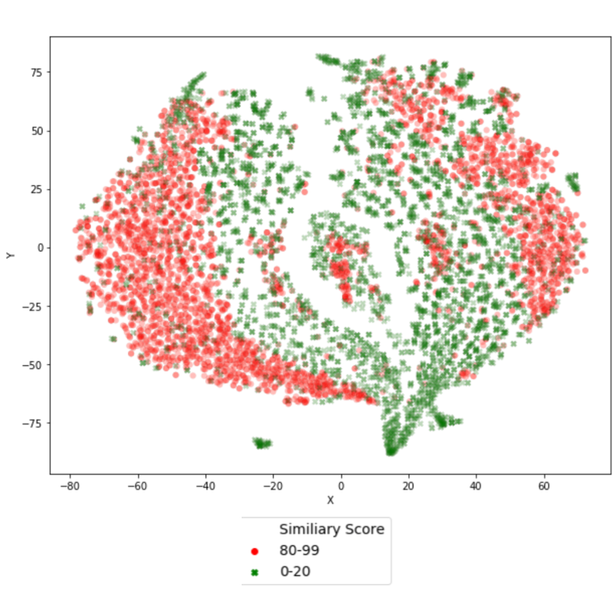
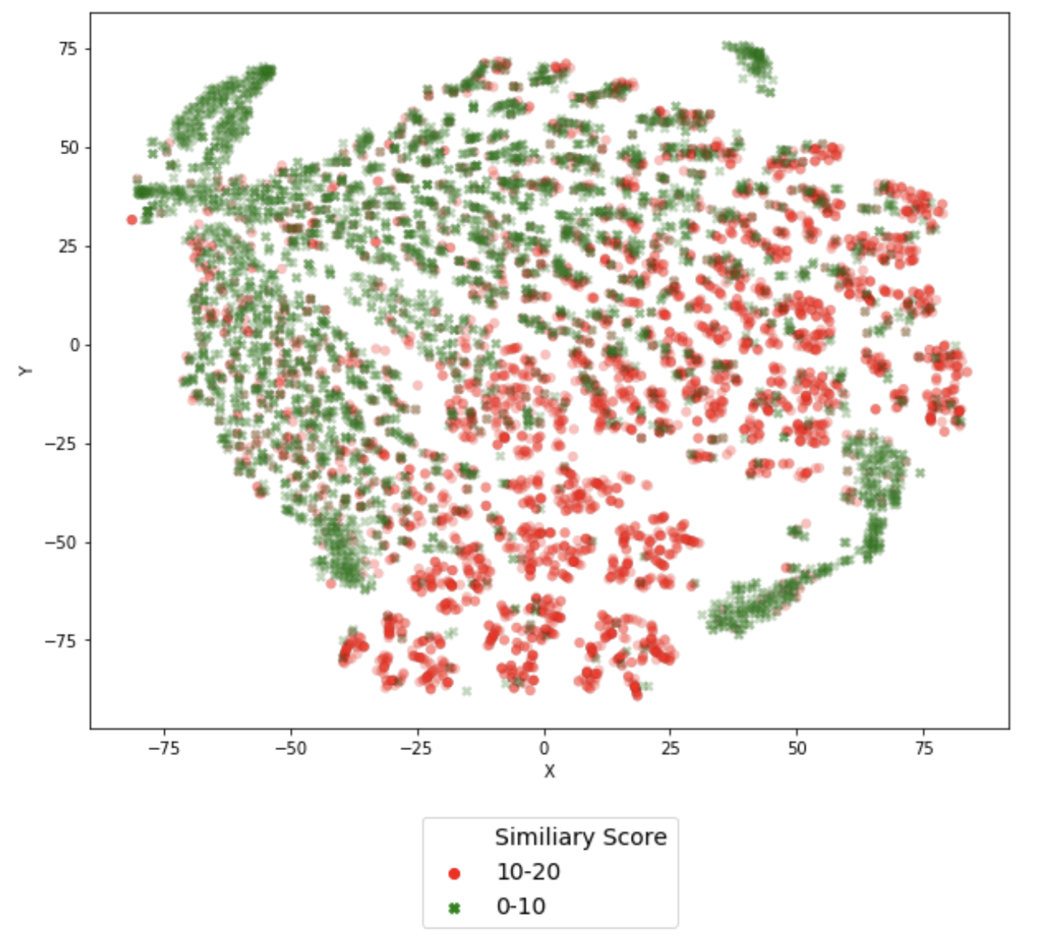
80-99 VS 0-20, 10-20 VS 0-10

Slide 7
Sample Segment 3: Segment of Globe readers with interest in Politics. Frequency 3/30 ( 79,966 users)
Score | # of Lookalikes | % of Lookalikes
90-99 | 2,202 | 0.004%
80-90 | 5,324 | 0.010%
70-80 | 12,467 | 0.023%
60-70 | 244,236 | 0.457%
50-60 | 453,520 | 0.849%
40-50 | 734,663 | 1.375%
30-40 | 1,245,291 | 2.331%
20-30 | 8,782,954 | 16.442%
10-20 | 37,411,700 | 70.034%
0-10 | 4,527,117 | 8.475%
Total | 53,419,474 | 100.000%
Notes:
/mnt/tgam_adc_s3/wecloud/segments/date=2020-07-09/58a43ad4-636a-49e9-9630-74eff6e79a7a.csv

Slide 8
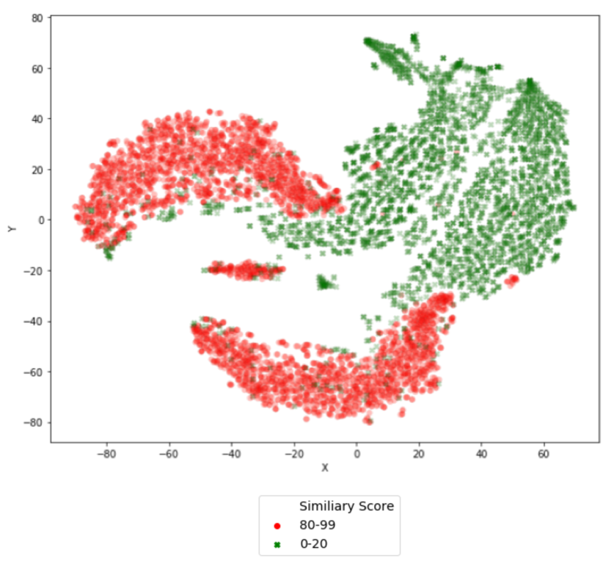
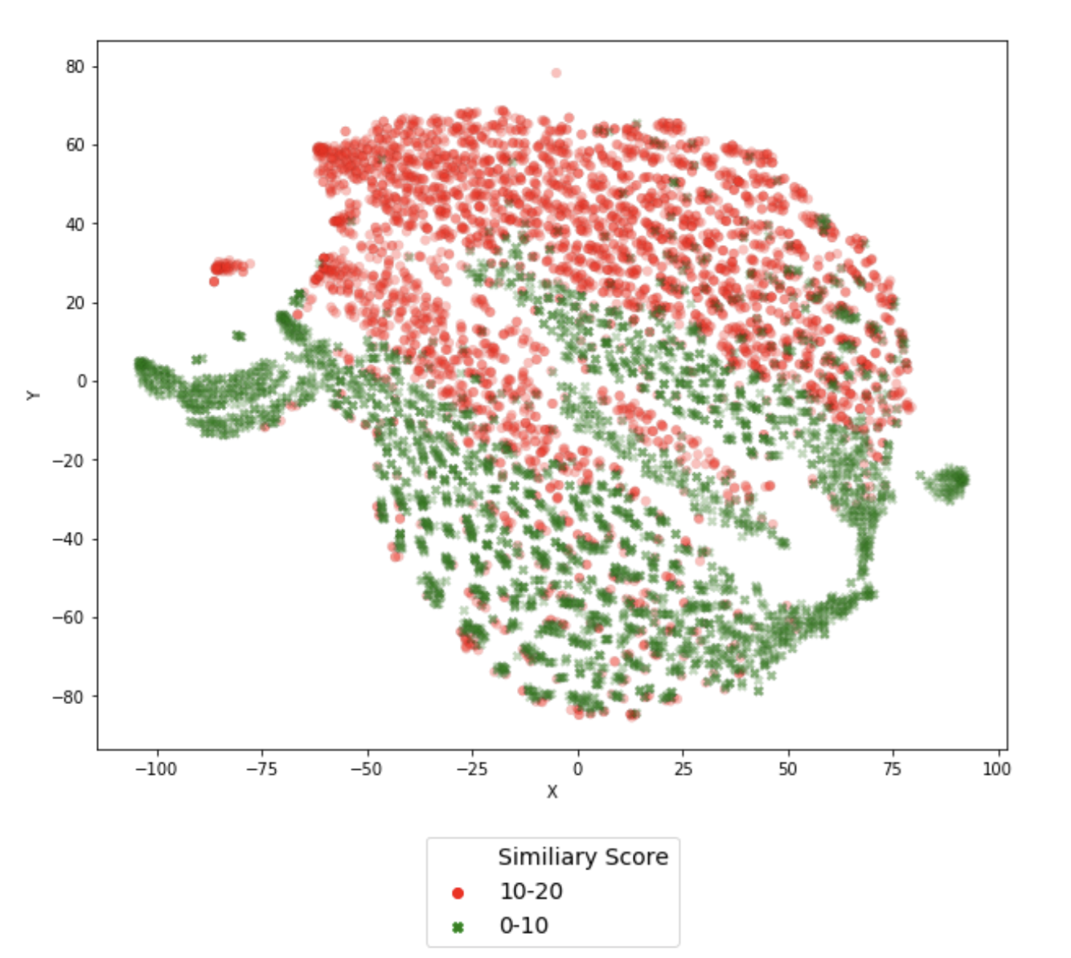
80-99 VS 0-20, 10-20 VS 0-10

Slide 9
Sample Segment 4: Segment of users who visit Globe and Mail website at least 3 times from Facebook in the last 30 Days (36,296 users)
Score | # of Lookalikes | % of Lookalikes
90-99 | 1,540,816 | 2.882%
80-90 | 1,219,641 | 2.281%
70-80 | 2,136,543 | 3.996%
60-70 | 5,325,390 | 9.961%
50-60 | 36,839,906 | 68.907%
40-50 | 731,266 | 1.368%
30-40 | 146,733 | 0.274%
20-30 | 115,800 | 0.217%
10-20 | 97,519 | 0.182%
0-10 | 5,309,523 | 9.931%
Total | 53,463,137 | 100.000%
Notes:
/mnt/tgam_adc_s3/wecloud/segments/date=2020-06-15/cfede868-c479-4897-8470-d33cc45c0947.csv

Slide 10
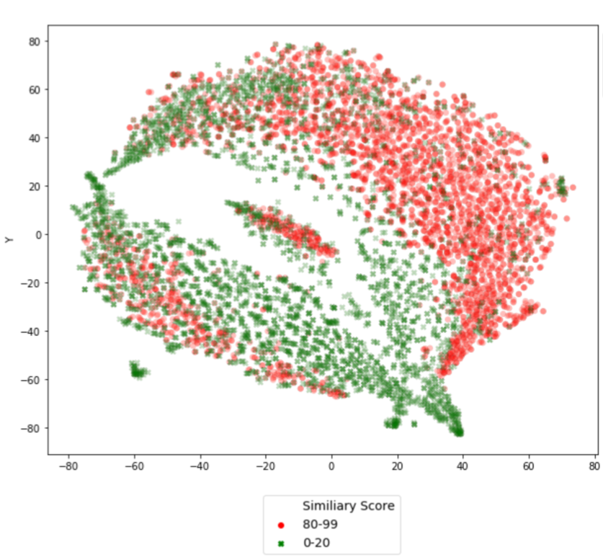
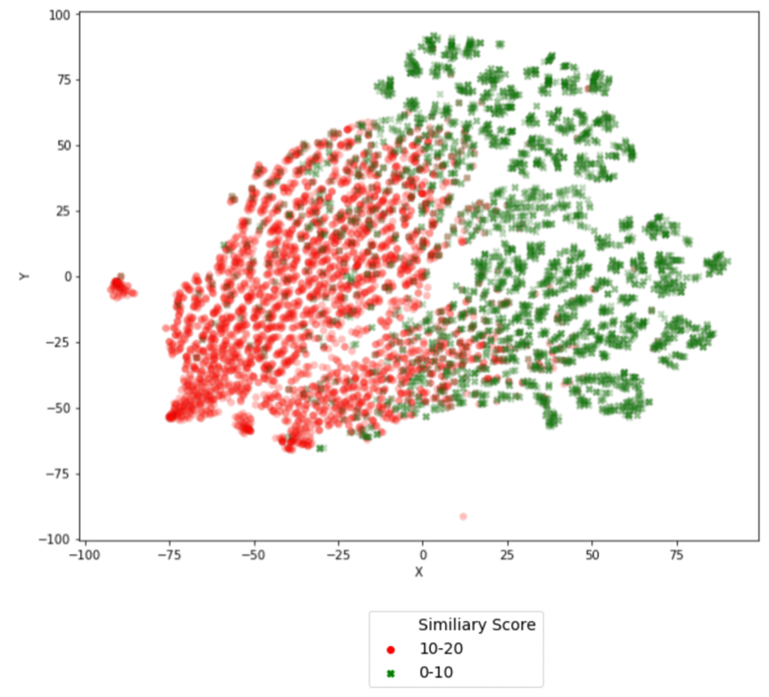
80-99 VS 0-20, 10-20 VS 0-10

Slide 11
Sample Segment 5: Segments of users who do site search for stock tickers of top 5 banks TD, Scotiabank, Royal Bank of Canada, BMO or CIBC (33,569 users)
Score | # of Lookalikes | % of Lookalikes
90-99 | 8,346 | 0.016%
80-90 | 22,221 | 0.042%
70-80 | 331,620 | 0.620%
60-70 | 867,818 | 1.623%
50-60 | 1,190,699 | 2.227%
40-50 | 3,399,016 | 6.357%
30-40 | 42,066,334 | 78.679%
20-30 | 687,630 | 1.286%
10-20 | 95,548 | 0.179%
0-10 | 4,796,638 | 8.971%
Total | 53,465,870 | 100.000%
Notes:
/mnt/tgam_adc_s3/wecloud/segments/date=2020-06-15/4eb26234-508a-4c13-819e-47d3761e18e7.csv

Slide 12
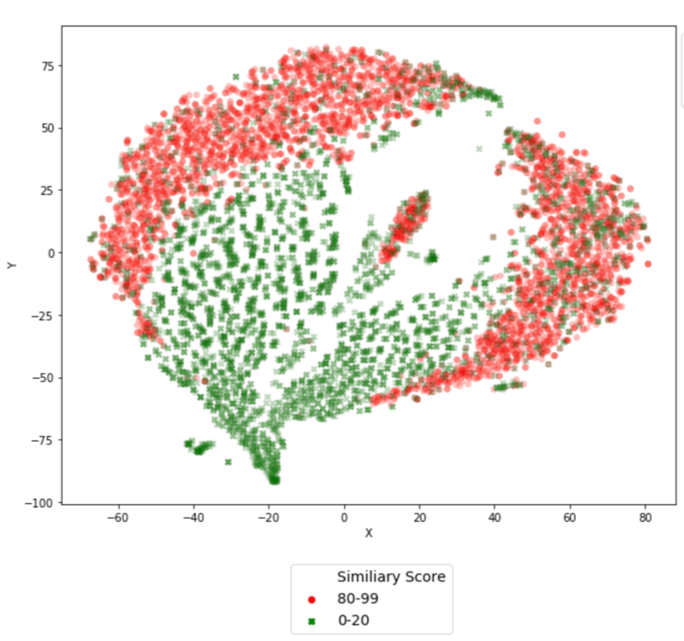
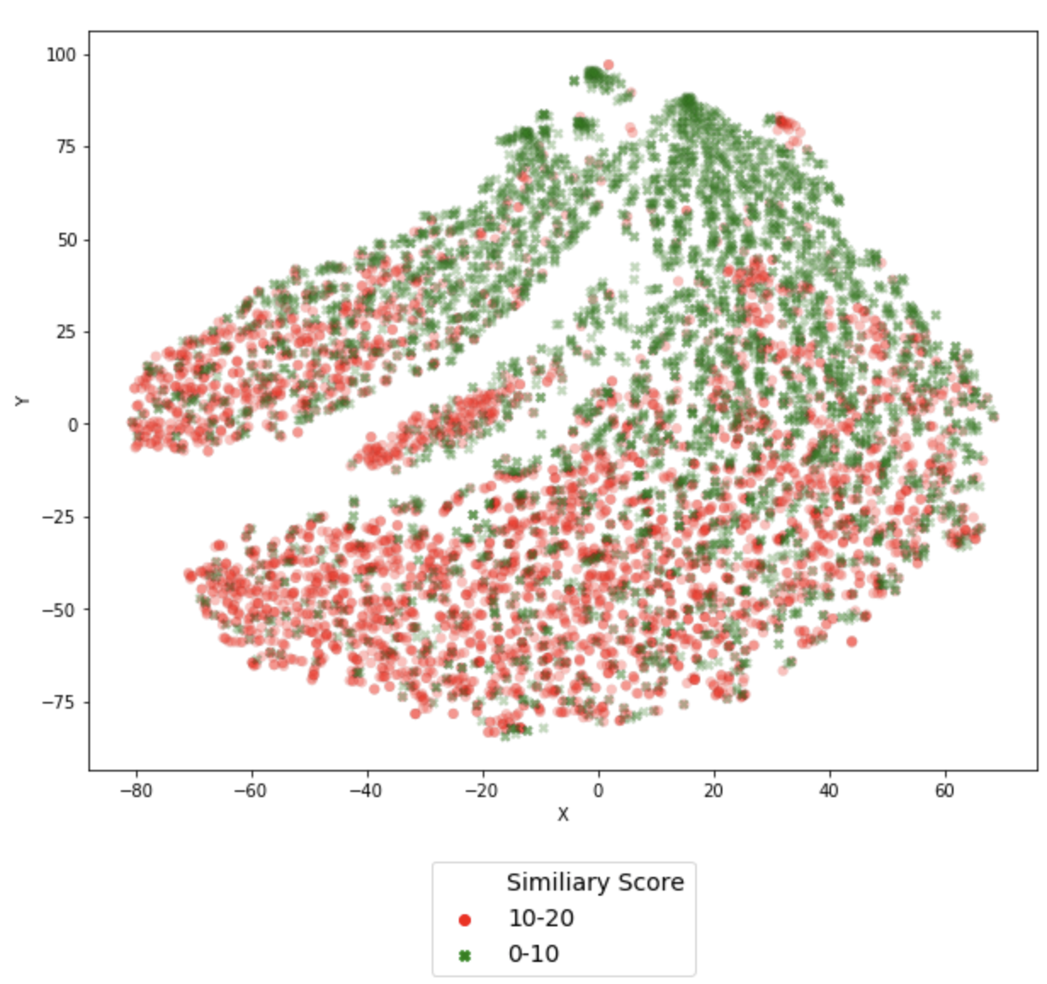
80-99 VS 0-20, 10-20 VS 0-10

Slide 13
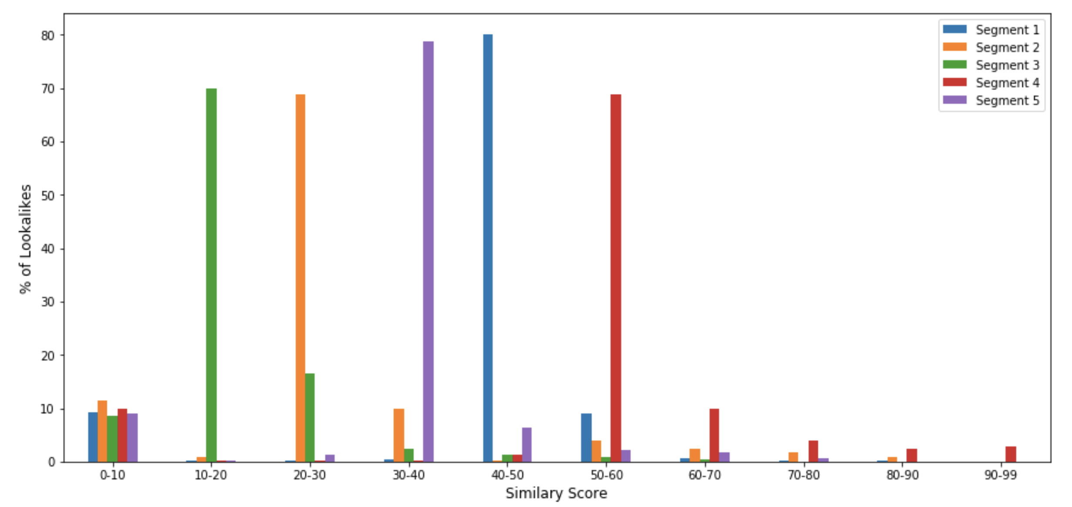
% of Lookalikes Distribution

Slide 14
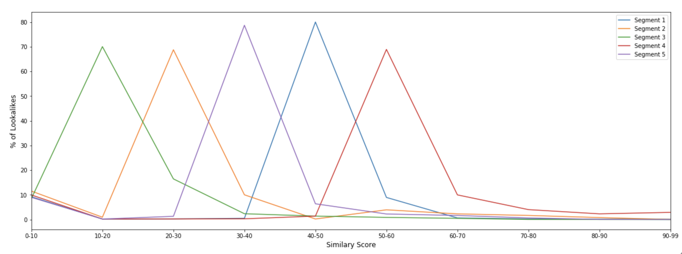
% of Lookalikes Distribution

Slide 15
Conclusion
Biggest sample size is around 70-80% of the entire population
Around 10% of population in the range of 0-10 similarity scores
Each segment has different peak based on the similarity of the entire population
By using TSNE visualizations, the lookalike model was able to separate the users at threshold 80-99 and 0-20

